Slide 1
Threat Mitigation
Aidana, Trevor, Michael, Winnie

Slide 2
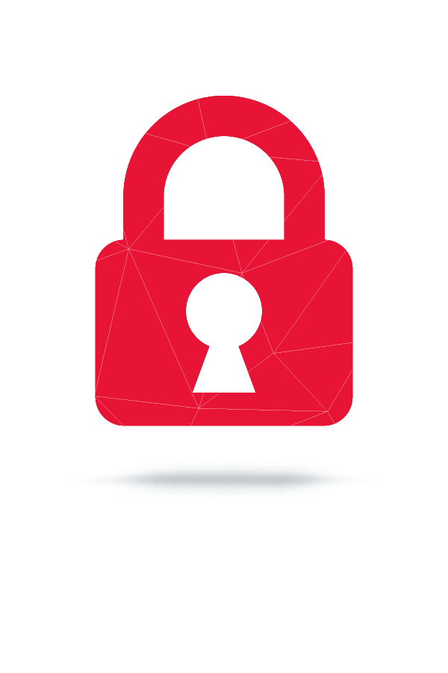
THREAT MITIGATION
What is threat mitigation?
Threat mitigation is a process used to reduce the extent of a problem or attack by isolating a threat until the problem can be remedied.
IT Threat mitigation is therefore defined as the corrective actions, preventions and remedies put in place to combat or reduce IT threats on a computer, server or network.
Cyber security threat mitigation refers to policies and processes put in place by companies to help prevent security incidents and data breaches as well as limit the extent of damage when security attacks happen.

Slide 3
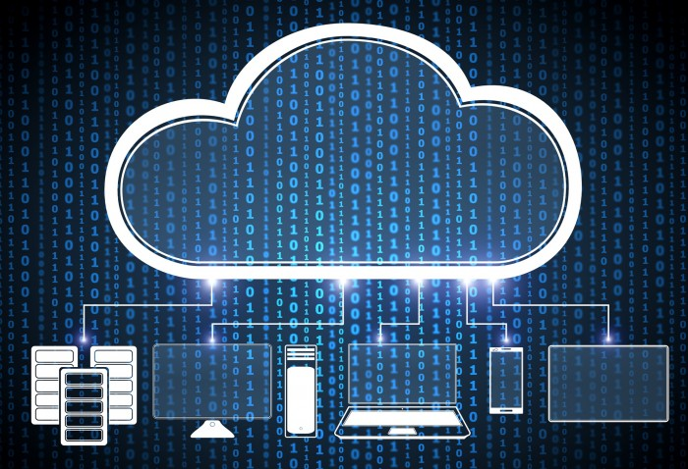
Threat-Mitigation Methods
Anti-malware / Malware detection
Encryption
Firewalls

Slide 4
Anti Malware
Anti Malware - Software that protects both Device and Network.
Malware detection examines networked devices and the data on those systems to detect malware. Malware-detection software is effective at detecting malware because it can involve the use of multiple mechanisms and methods. Types of malware-detection software include anti-virus software, anti-spyware, anti-spam, and firewalls.
Malware - malicious software that intends to damage a Computer, Client, Server, or network. There are examples of Malware: Ransomware, Spyware, Viruses.Types of malware include viruses, worms, trojan horses, rootkits, ransomware, and keyloggers.

Slide 5
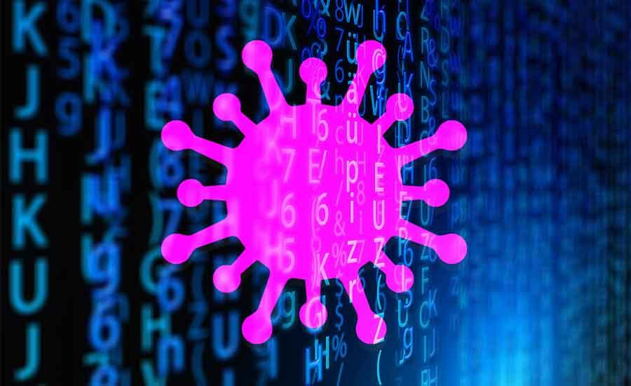
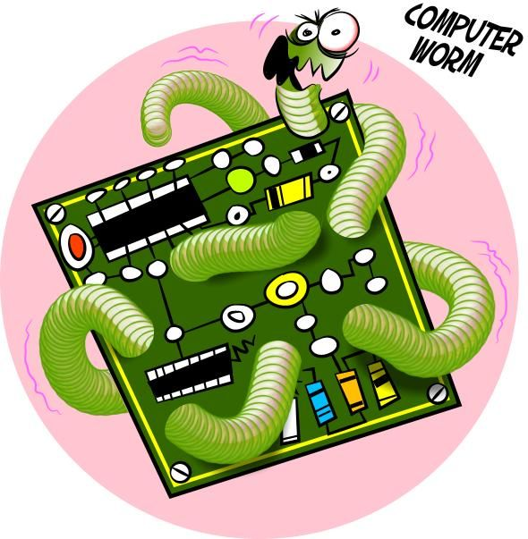
 | Virus is a program written to enter to your computer and damage your files and data. A virus might corrupt, or delete data on your computer, also replicate themselves. They can enter to your computer as an attachment of images, greeting, or audio, video files. Viruses also enters through downloads on the Internet. They can be hidden in a free softwares or other files that you download.
 | Worms are malicious programs that make copies of themselves again and again on the local drive, network shares, etc. The only purpose of the worm is to reproduce itself again and again. It doesn’t harm any data, or file on the computer. Unlike a virus, it does not need to attach itself to an existing program. Worms spread by exploiting vulnerabilities in operating systems. Due to its replication nature it takes a lot of space in the hard drive and consumes more CPU uses which in turn makes the pc too slow also consumes more network bandwidth.

Slide 6
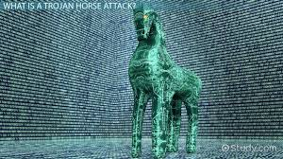
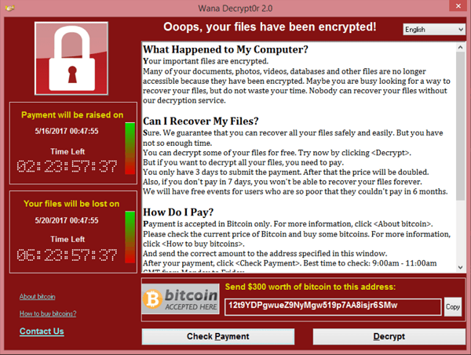
 | A Trojan horse is not a virus. Trojans do not replicate themselves but they can be just as destructive. They open a backdoor entry to your computer which gives malicious users or programs access to your system, allowing confidential and personal information to be theft.
 | Ransomware uses asymmetric encryption. This is cryptography that uses a pair of keys to encrypt and decrypt a file. The public-private pair of keys is uniquely generated by the attacker for the victim, with the private key to decrypt the files stored on the attacker’s server. The attacker makes the private key available to the victim only after the ransom is paid, though as seen in recent ransomware campaigns, that is not always the case. Without access to the private key, it is nearly impossible to decrypt the files that are being held for ransom.

Slide 7
Rootkits are the most dangerous, both in the damage they can cause and the difficulty you might have in finding and removing them.
Rootkits are a type of malware that are designed so that they can remain hidden on your computer. But while you might not notice them, they are active.
Rootkits can contain a number of tools, ranging from programs that allow hackers to steal your passwords to modules that make it easy for them to steal your credit card or online banking information. Rootkits can also give hackers the ability to subvert or disable security software and track the keys you tap on your keyword, making it easy for criminals to steal your personal information.
Keyloggers represent a major threat to your cybersecurity because they’re able to secretly capture and record the sensitive data you type onto your keyboard. A lot of information can be gathered from what you enter on your devices — via your emails, text messages, login credentials, passwords used, websites browsed, and financial information accessed.
Cybercriminals can use keyloggers as malware to steal your personally identifiable information. That might include financial information, PIN codes for financial accounts, credit card numbers, usernames, passwords, and other private data. After cybercriminals access this information, they may be able to commit financial fraud and identity theft.

Slide 8
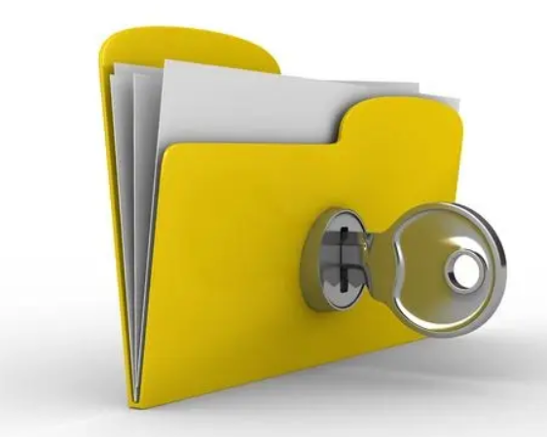
ENCRYPTION
What is encryption?
Encryption is the process of taking plain
text and scrambling it into ciphertext that
is unreadable. A key is used to encrypt and
decrypt a message or data from the sender
to the party that is receiving the file.

Slide 9
WHY HAVE ENCRYPTION?
Privacy: Encryption helps ensures that only the right people read data. It helps prevent potential bad actors from reading sensitive date like hackers, ISPs, governments.
Security: Encryption helps prevent data breaches. Lost or stolen devices and hard drives are more secure if they are encrypted.
Data Integrity: Encryption helps protect integrity of data sent across the internet. Helping to make sure that data isn’t tampered with.
Authentication: A public key encryption can be used to allow the owner of website to help users verify they are connected to the real website.
Regulations: Many industry and government regulations require encryption such as HIPPA and credit card companies (PCI DSS).

Slide 10
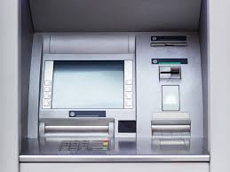

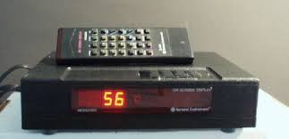
ENCRYPTION IN EVERYDAY LIFE
Encryption is used with ATMs to messenger apps to email to cable TV. Older generations of people can remember black box or descrambler cable boxes that decrypted paid channels. Credit card charges are encrypted to protect sensitive data. The government agencies encrypt devices, hard drives and computers to help protect secrets. Encryption is everywhere and vital to threat mitigation.

Slide 11
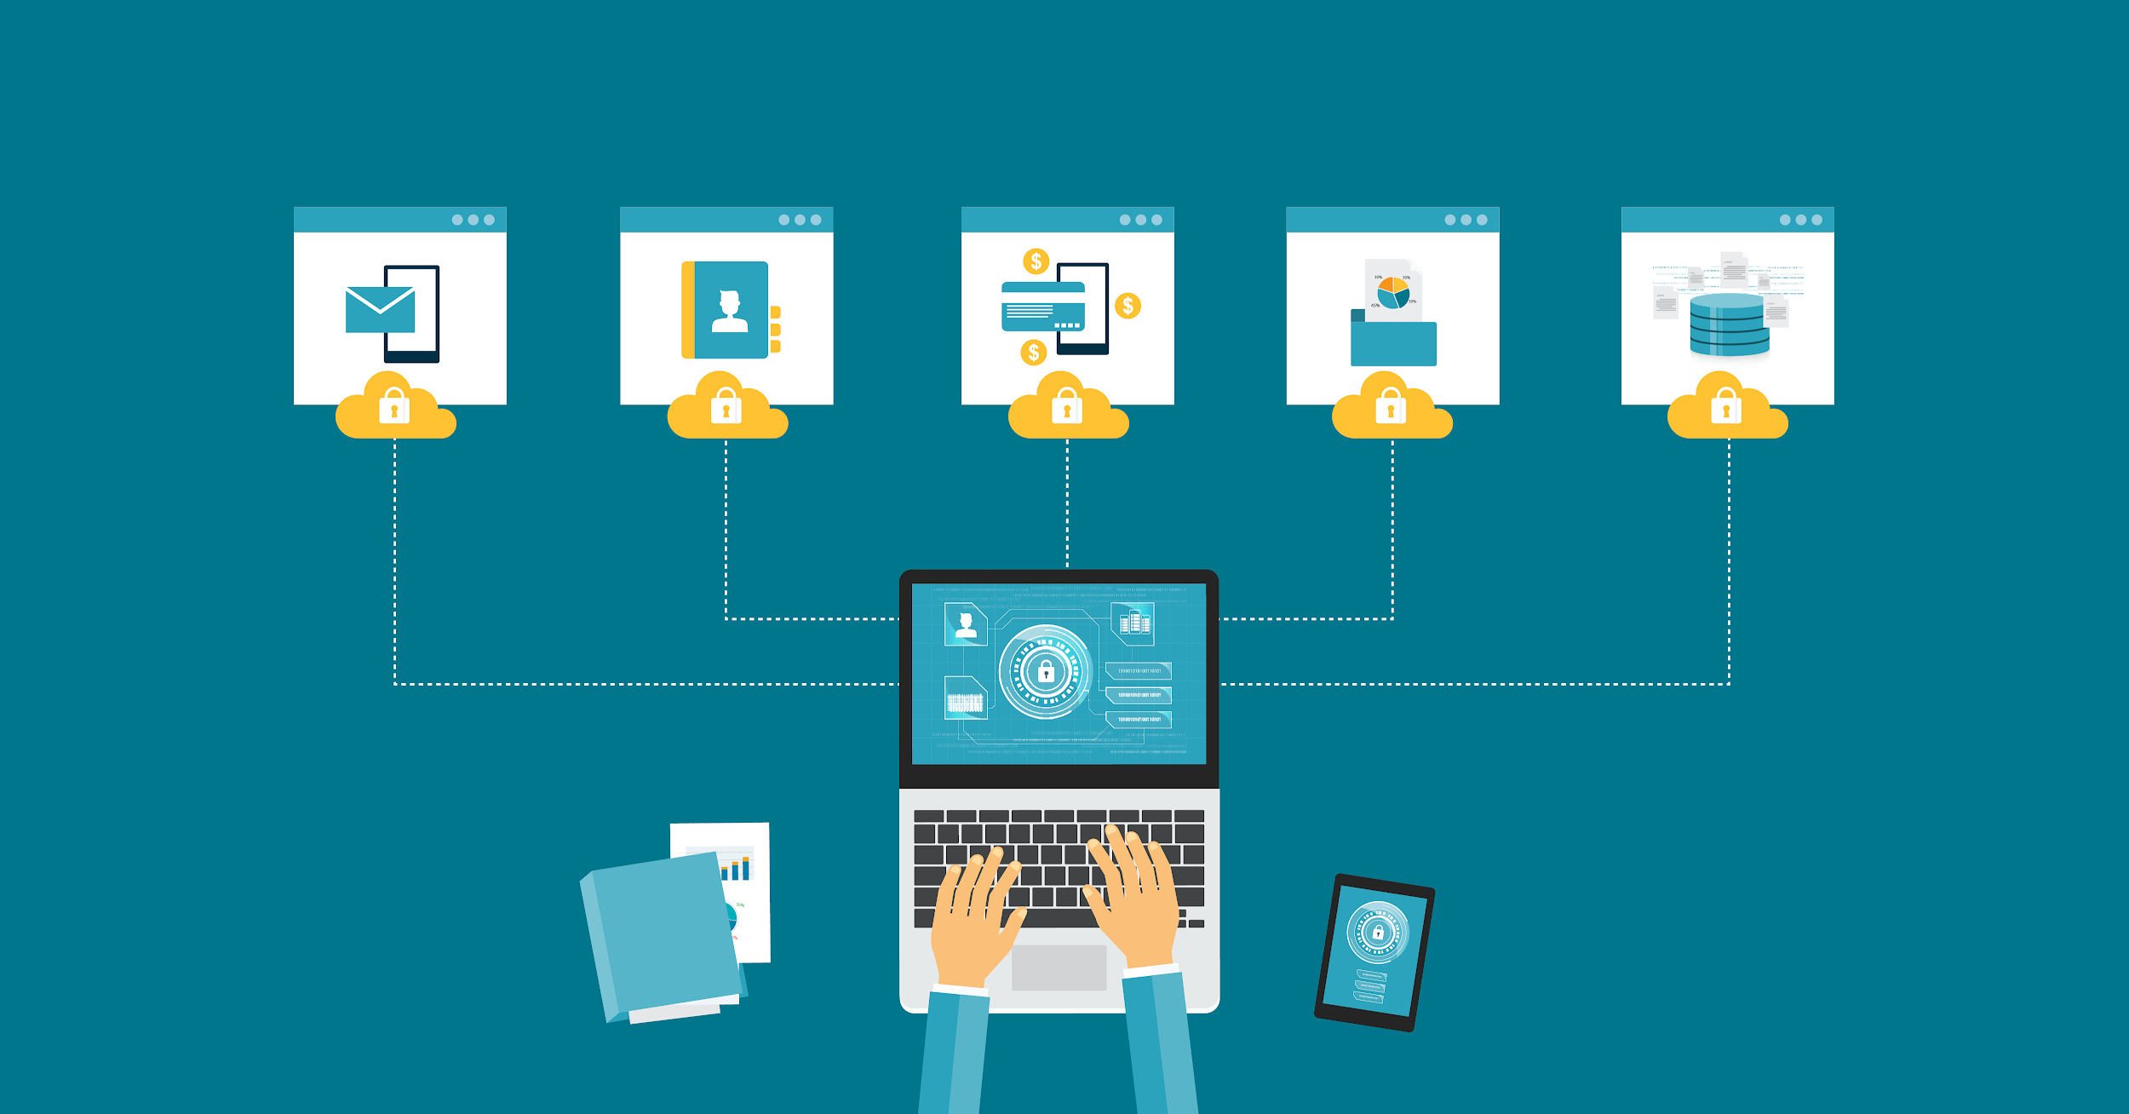

Slide 12
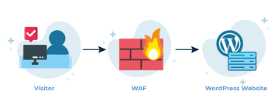
Firewall
A firewall is a network security device that monitors incoming and outgoing network traffic and decides whether to allow or block specific traffic based on a defined set of security rules.
Network security >25 years
A firewall can be hardware, software, or both.

Slide 13
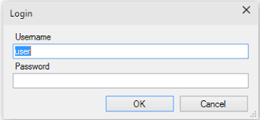
SQL injection attract:
select * from users where USERNAME = ‘user’
and PASSWORD =’super’
administrator --
Select * from users where USERNAME = ‘administrator’
-- and PASSWORD =’ ’

Slide 14
Web application firewall
Will monitors the traffic which goes in and out of the web servers and identifies patterns that constitute a threat.
Essentially, it is a barrier put between the web application and the Internet.
Will keep monitoring the applications and the GET and POST requests it receives to find and block malicious traffic
· SQL injection
· Cross-site scripting (XSS)
· Session hijacking
· Distributed denial of service (DDoS) attacks
· Cookie poisoning
· Parameter tampering

